Slide 1

smart METAL Detector
By
E SAI PRKASH GOUD -220350330005
G SAI GOUTHAM- 220350330006
GATLA SAISHIVA REDDY- 220350330007
GHANTASALA MANASA- 220350330008

Slide 2
TABLE OF CONTENTS
INTRODUCTION
PRINCIPLE OF OPERATION
METAL DETECTORS
SENSORS NEEDED
BLOCK DIAGRAM
APPLICATION
CONCLUSION
BIBLIOGRAPHY

Slide 3
INTRODUCTION
Metal detector is a device that can detect metal, the basics can make a sound when it is near some metal.
In 1881, Alexander Graham Bell invented the first metal detector. As President James Garfield lay dying of an assassin's bullet, Bell hurriedly invented a crude metal detector in an unsuccessful attempt to locate the fatal slug. Bell's metal detector was an electromagnetic device he called the induction balance. The need for detection is very clear to protect our self from any kind of danger.
In 1925, Gerhard Fischar invented a portable metal detector. Fischar's model was first sold commercially in 1931 and Fischar was behind the first large-scale production of metal detectors.

Slide 4
NEED FOR METAL DETECTORS
The metal detector should always work in an accurate & precise manner. These find wide usage in many industrial processes. They are tremendously used in important sites like airport, railways, hotels, military facility, and various other government buildings for providing security. They are usually used in detecting weapons, gold or any other metal at these sites. They also find applications in civil engineering. It is widely used in archaeology to search relics.

Slide 5
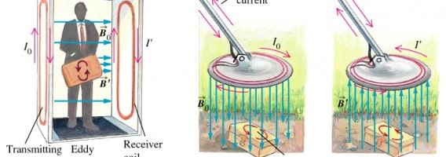
PRINCIPLE OF OPERATION
The operation of metal detectors is based upon the principles of electromagnetic induction.
Metal detectors contain one or more inductor coils that are used to interact with metallic elements on the ground.
The single-coil detector illustrated below is a simplified version of one used in a real metal detector.
A pulsing current is applied the coil, which then induces a magnetic field. When the magnetic field of the coil moves across the coil, the field induces an electric current(called eddy currents) in the metal. The eddy currents induce their own magnetic field , which generates an opposite an opposite current in the coil, which induces a signal indicating the presence of metal.

Slide 6
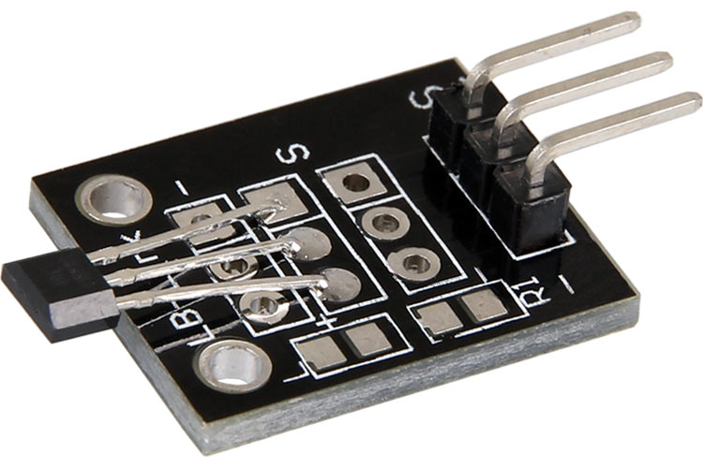
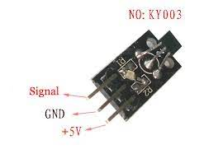
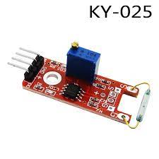
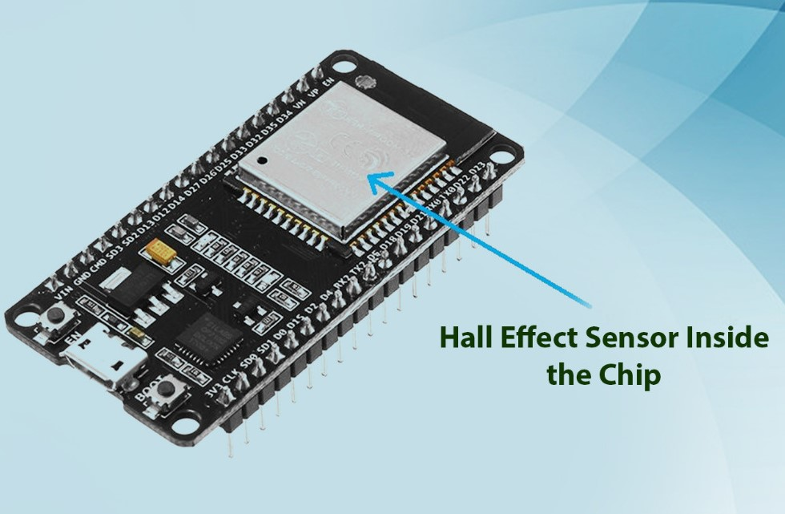
SENSORS
KY-024 LINEAR HALL MAGNETIC SENSOR
KY-035 ANALOG HALL SENSOR
KY-003 HALL MAGNETIC SENSOR
KY-025 REED SWITCH
INBUILT HALL SENSOR ESP32

Slide 7
HALL effect sensors
The hall effect sensor is a type of magnetic sensor which can be used for detecting the strength and direction of a magnetic field produced from a permanent magnet or an electromagnet with its output varying in proportion to the strength of the magnetic field being detected.
Hall Effect Sensors are devices which are activated by an external magnetic field. We know that a magnetic field has two important characteristics flux density, (B) and polarity (North and South Poles).
The output signal from a Hall effect sensor is the function of magnetic field density around the device. When the magnetic flux density around the sensor exceeds a certain pre-set threshold, the sensor detects it and generates an output voltage called the Hall Voltage, V_{H}.

Slide 8
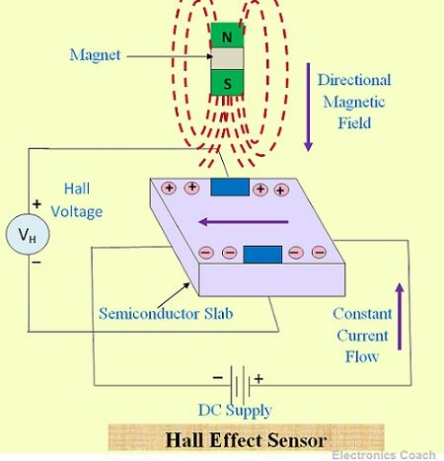
HALL EFFECT SENSOR PRINCIPLE
Hall Effect Sensors consist basically of a thin piece of rectangular p-type semiconductor material such as gallium arsenide (GaAs), indium antimonide (InSb) or indium arsenide (InAs) passing a continuous current through itself. When the device is placed within a magnetic field, the magnetic flux lines exert a force on the semiconductor material which deflects the charge carriers, electrons and holes, to either side of the semiconductor slab. This movement of charge carriers is a result of the magnetic force they experience passing through the semiconductor material.
As these electrons and holes move side wards a potential difference is produced between the two sides of the semiconductor material by the build-up of these charge carriers. Then the movement of electrons through the semiconductor material is affected by the presence of an external magnetic field which is at right angles to it and this effect is greater in a flat rectangular shaped material. The effect of generating a measurable voltage by using a magnetic field is called the Hall Effect.

Slide 9
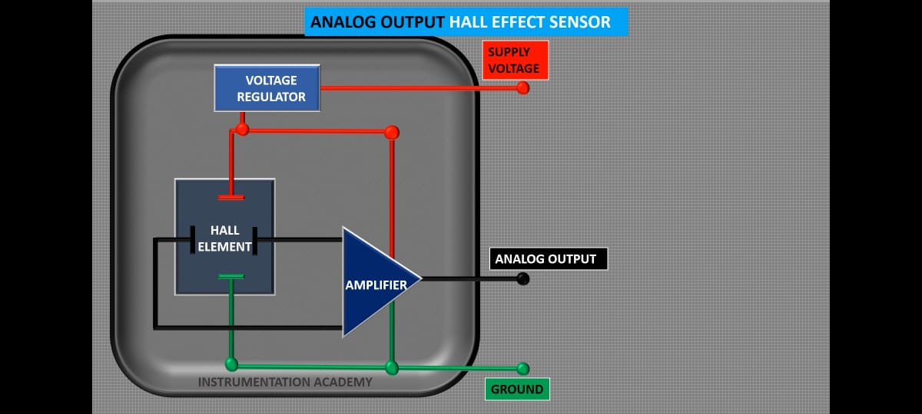
ANALOG HALL SENSOR
It is important to detect and measure magnetic field of any component in many industrial applications. If you want to detect if the magnetic tip of the tool is still magnetized or if electromagnet you designed to separate magnetic objects from heap of scrap the test of magnetic field is a must and electromagnets are quite big in size so we need a sensor which is small and portable to be used everywhere in need. The KY-035 Hall Effect Magnetic Sensor Module is an analog sensor which reads the strength of magnetic field and outputs the corresponding voltage at the analog output pin. It is a 5V sensor and it can be used with Microcontrollers and development boards like ESP32,Arduino, Raspberry Pi, ARM and PIC etc.

Slide 10
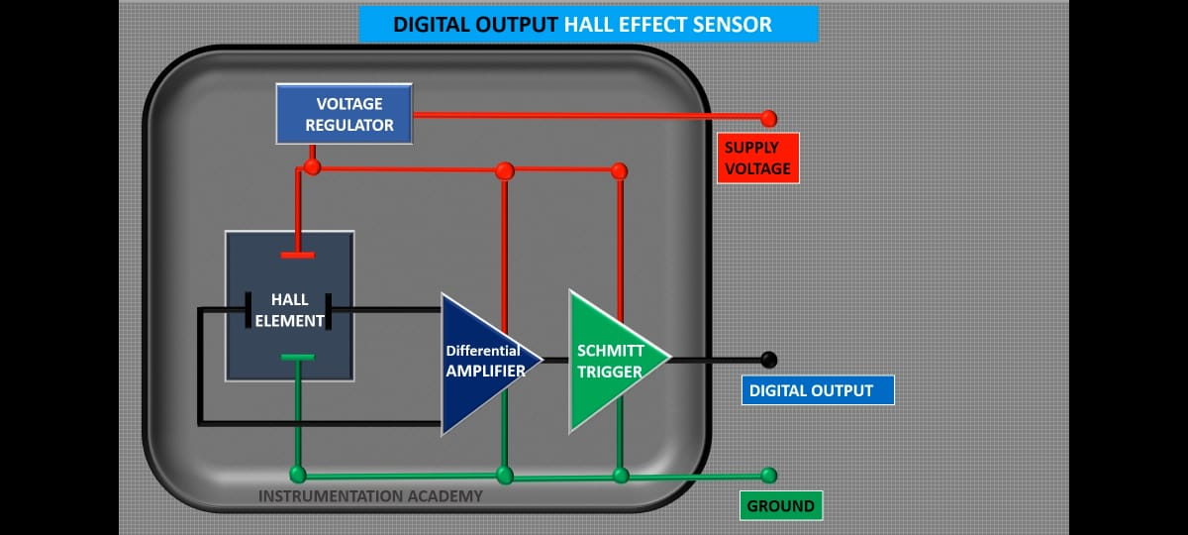
MAGNETIC HALL SENSOR
The hall effect sensor is just like switch as it works on hall effect principle so, it is more sensitive to magnetic flux and suitable for harsh environment because of semiconductor type casing and no glass encapsulation. This Ky003 Hall Effect/Magnetic Sensor module has 3144EUA-S hall effect sensor, it changes its state if one pole of magnet comes near it which can be easily read by any Digital GPIO pin on the Microcontroller board. This is ideal for commercial, consumer and industrial applications like measuring the RPM of the wheel, position sensor for machining tools, positional feedback for control systems, detecting the poles of magnets in BLDC Motors, magnetic alarm doors etc.

Slide 11
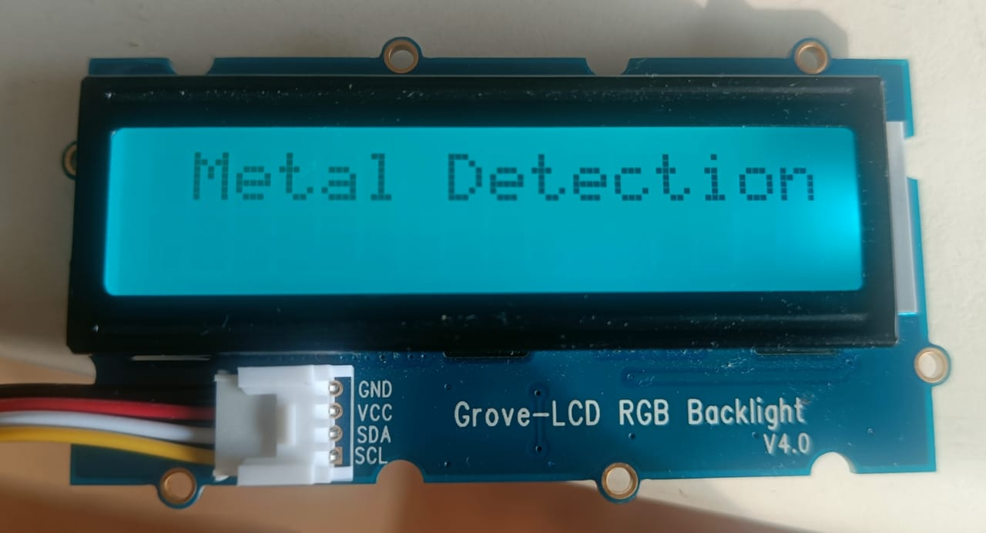
GROVE –LCD RGB BACKLIGHT
Grove-LCD RGB backlight enables you to set the colour to whatever you like via the simple and concise Grove interface. It takes I2C as communication method with your microcontroller. So number of pins required for data exchange and backlight control shrinks from ~10 to 2, relieving IOs for other challenging tasks.Grove - LCD RGB Backlight supports user-defined characters.
Here lcd is used to display the values when detected.

Slide 12
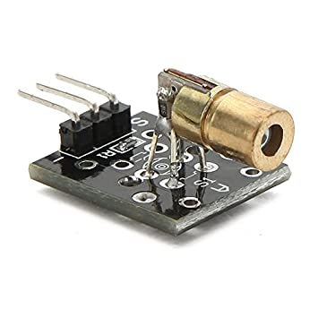
KY-008 LASER EMITTER
The KY-008 Laser Transmitter module can be used as a laser pointer. It emits a dot shaped, red laser beam.
Here the laser emitter is used to pin point the location of the detected metal.

Slide 13
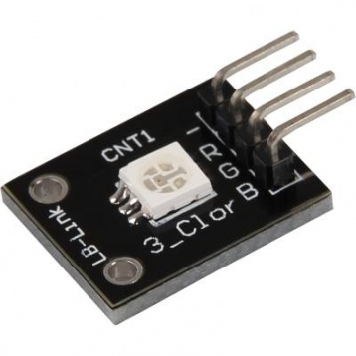
KY 009 SMD RGB
The KY-009 RGB Full Colour LED module emits a range of colours by mixing red, green, and blue light. Each colour is adjusted by using PWM.

Slide 14
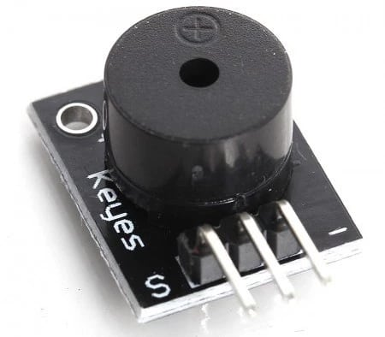
BUZZER
The Buzzer module can produce a range of sound tones depending on the input signal frequency(ie HIGH or LOW).

Slide 15
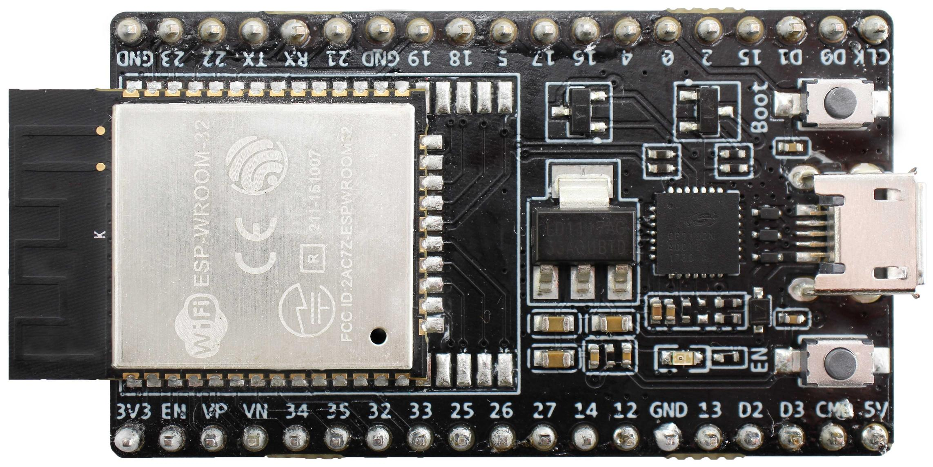
ESP32 WROOM 32D
ESP32-WROOM-32D and ESP32-WROOM-32U are powerful, generic Wi-Fi + Bluetooth + Bluetooth LE MCU modules that target a wide variety of applications, ranging from low-power sensor networks to the most demanding tasks, such as voice encoding, music streaming and MP3 decoding. At the core of the two modules is the ESP32-D0WD chip that belongs to the ESP32 series* of chips. The chip embedded is designed to be scalable and adaptive. There are two CPU cores that can be individually controlled, and the CPU clock frequency is adjustable from 80 MHz to 240 MHz. The chip also has a low-power coprocessor that can be used instead of the CPU to save power while performing tasks that do not require much computing power, such as monitoring of peripherals. ESP32 integrates a rich set of peripherals, ranging from capacitive touch sensors, Hall sensors, SD card interface, Ethernet, high-speed SPI, UART, I2S and I2C.

Slide 16
BLOCK DIAGRAM
BLYNK
HALL SENSOR
LCD
ESP32 WROOM 32D
LASER
LED
BUZZER

Slide 17
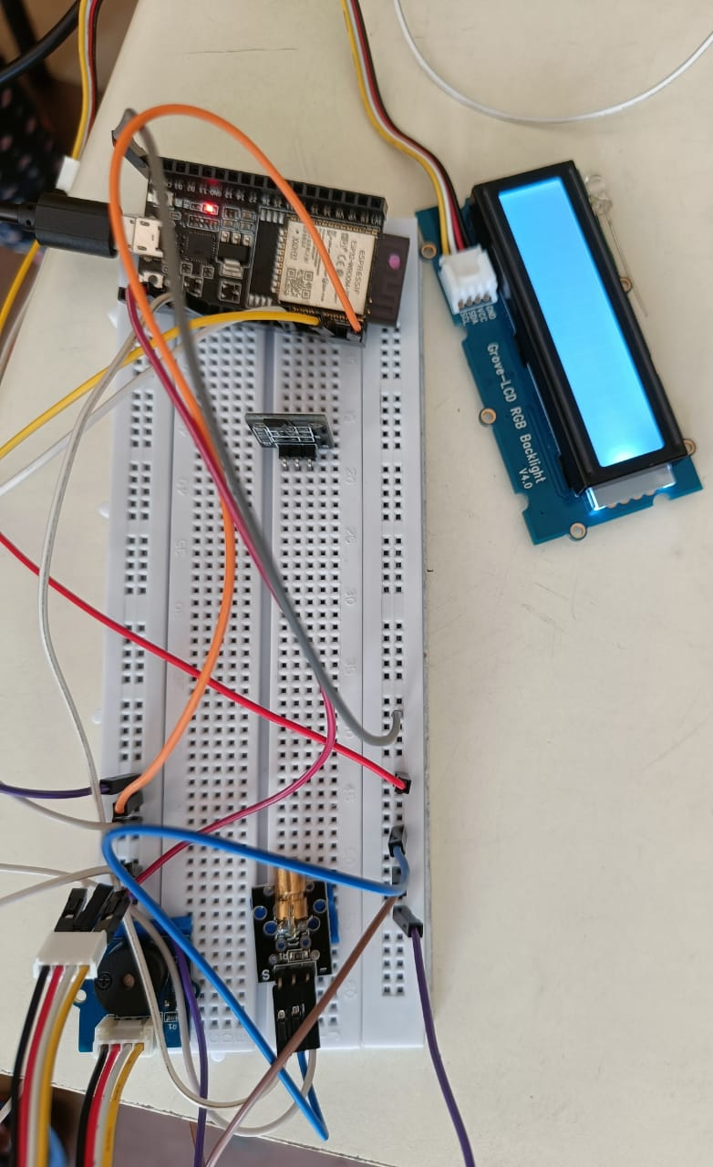
circuit

Slide 18
APPLICATIONS
Airport and building security
Ferrous metal detector
In construction industry
Geological research and Archaeology exploration

Slide 19
CONCLUSION
Equipment is compact, simple in design and can be used practically anywhere needed.
The metal detector gives a range upto 10mm.

Slide 20
BIBLIOGRAPHY
Wiki.seedstudio.com
www.Wikipedia.com
www.expressif.com

